Slide 1
Panoptic Segmentation
Sakthi S (19PW27)
Sneha G (19PW36)

Slide 2
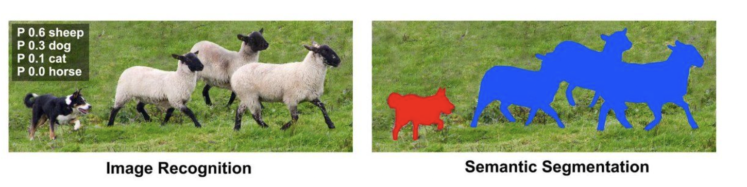
Semantic segmentation
Semantic segmentation is a deep learning algorithm that associates a label or category with every pixel in an image. Semantic Segmentation follows three steps:
Classifying : Classifying a certain object in the image.
Localizing : Finding the object and drawing a bounding box around it.
Segmentation : Grouping the pixels in a localized image by creating a segmentation mask.

Slide 3
Semantic segmentation
The task of Semantic Segmentation can be referred to as classifying a certain class of image and separating it from the rest of the image classes by overlaying it with a segmentation mask.
Note: This is significantly different from classification. Classification assigns a single class to the whole image whereas semantic segmentation classifies every pixel of the image to one of the classes.
Notes:
The classification process is easier than segmentation, in classification all objects in a single image is grouped or categorized into a single class. While in segmentation each object of a single class in an image is highlighted with different shades to make them recognizable to computer vision.

Slide 4
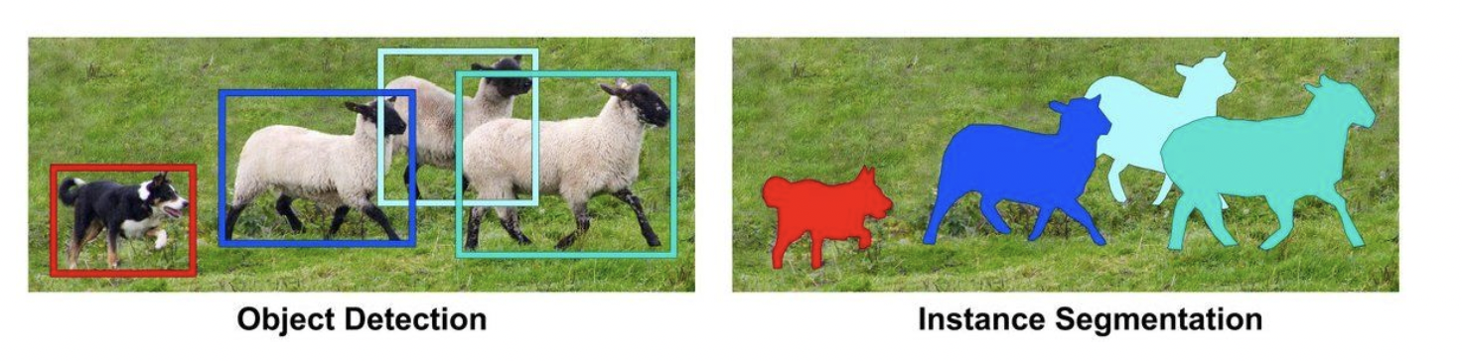
Instance segmentation
Instance segmentation involves identifying boundaries of the objects at the detailed pixel level, making it a complex task to perform.Instance segmentation contains 2 significant parts:
Object Detection: Firstly, it runs object detection to find all bounding boxes for every object in an image
Semantic Segmentation: After finding all the rectangles (bounding boxes), it uses a semantic segmentation model inside every rectangle
Notes:
Instance segmentation includes identification of boundaries of the objects at the detailed pixel level. For example, in the image below there are 7 balloons at certain locations, and these are the pixels that belong to each one of the balloons.

Slide 5
Instance Segmentation
Note: Instance segmentation only differentiates all instances in each class; for example, it will separate every person into a different class.

Slide 6
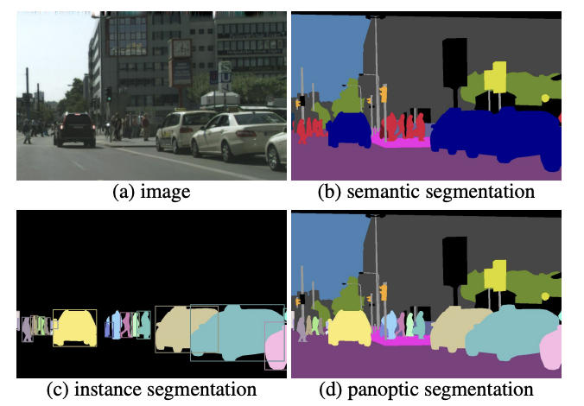
Panoptic segmentation
Panoptic segmentation unifies the typically distinct tasks of semantic segmentation (assign a class label to each pixel) and instance segmentation (detect and segment each object instance)
It was introduced by Alexander Kirillov and his team in 2018.

Slide 7
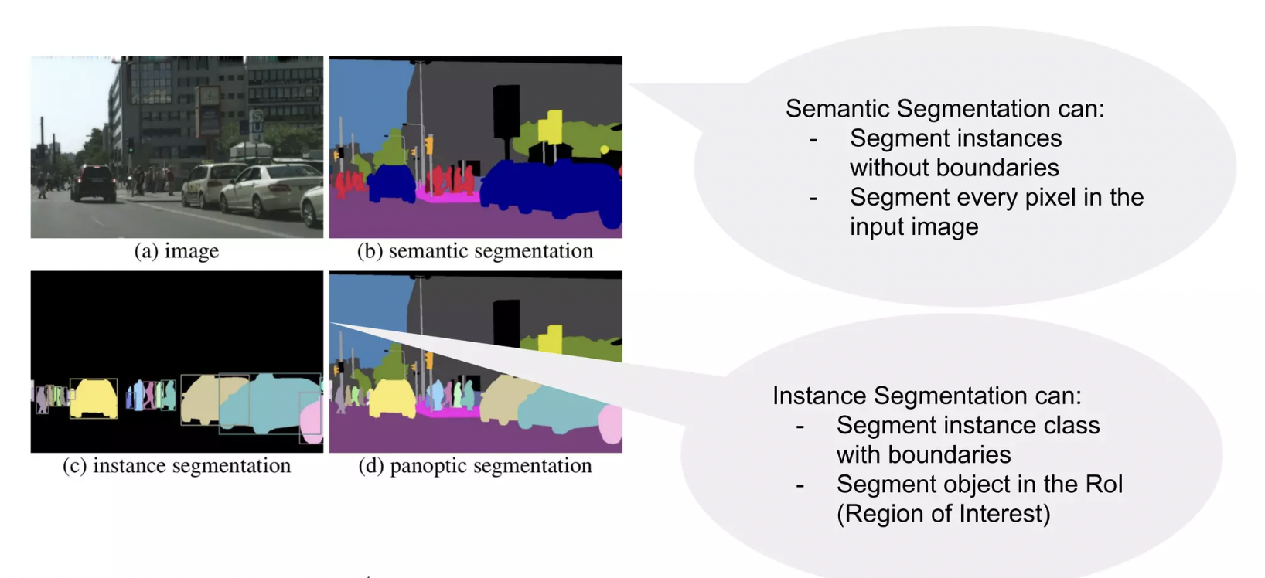

Slide 8
Panoptic Segmentation
The task of panoptic segmentation can be broken down into three simple steps:
Separating each object in the image into individual parts, which are independent of each other.
Painting each separated part with a different color—labeling.
Classifying the objects.
The goal of panoptic segmentation is to holistically generalize the task of image segmentation rather than using two different approaches separately or, as the authors defined it, “the unified or global view of segmentation”.

Slide 9
Semantic Vs Instance Vs Panoptic
Semantic segmentation is used to study stuff as they are more amorphous or not well defined, while instance segmentation is used to study things as they are well defined which makes it easier to classify and detect.
Semantic segmentation creates a unified segmentation mask across objects belonging to the same class while instance segmentation creates individual segmentation masks for each and every object in the image.
Panoptic segmentation combines both—it identifies the objects with respect to class labels and also identifies all the instances in the given image.
Notes:
In computer vision, the term things generally refers to objects that have properly defined geometry and are countable, like a person, cars, animals, etc.Stuff is the term used to define objects that don’t have proper geometry but are heavily identified by the texture and material like the sky, road, water bodies, etc.

Slide 10
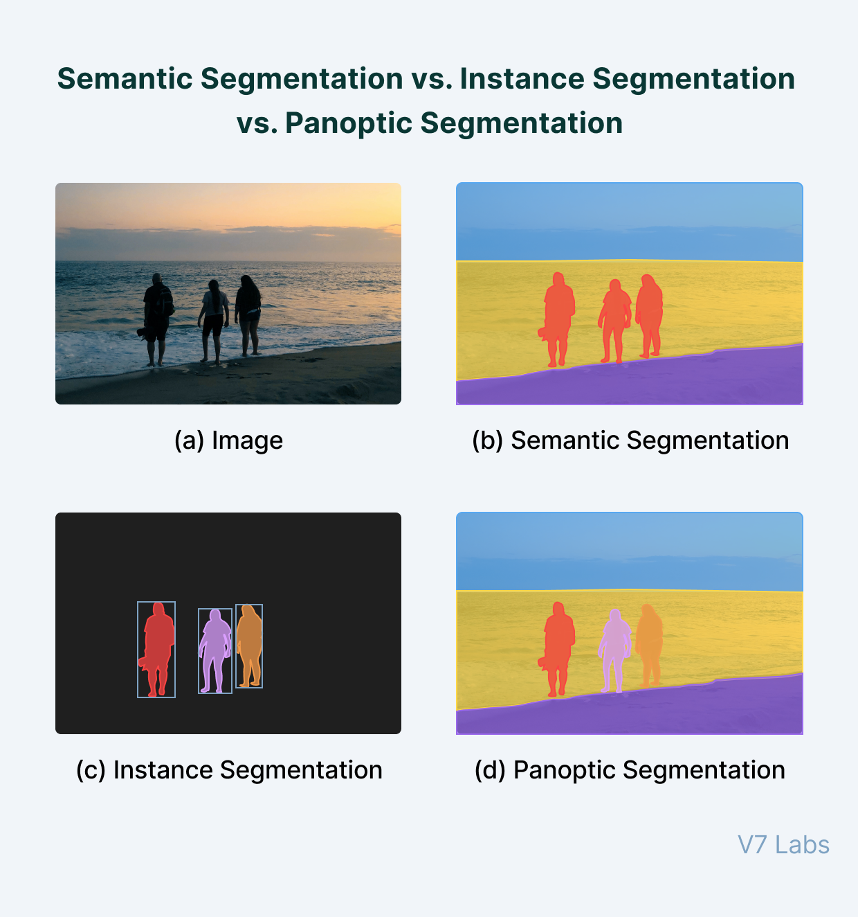

Slide 11
What’s the challenge in this task?

Slide 12
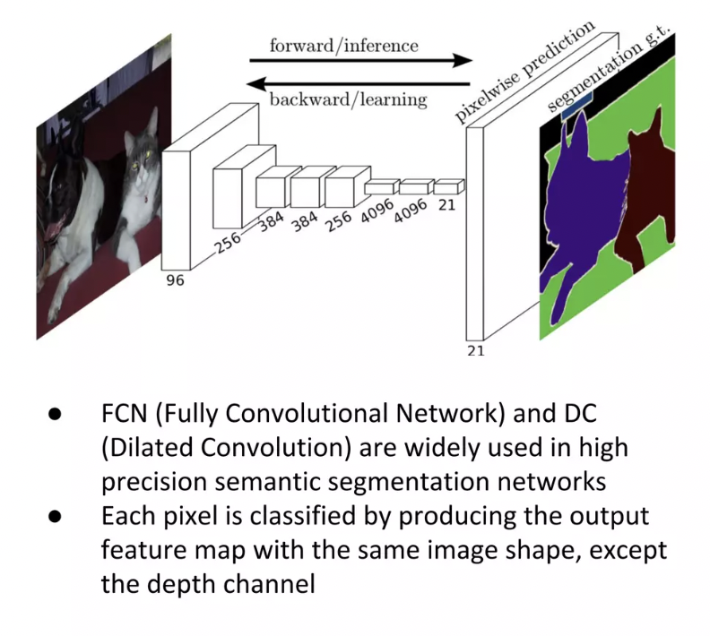
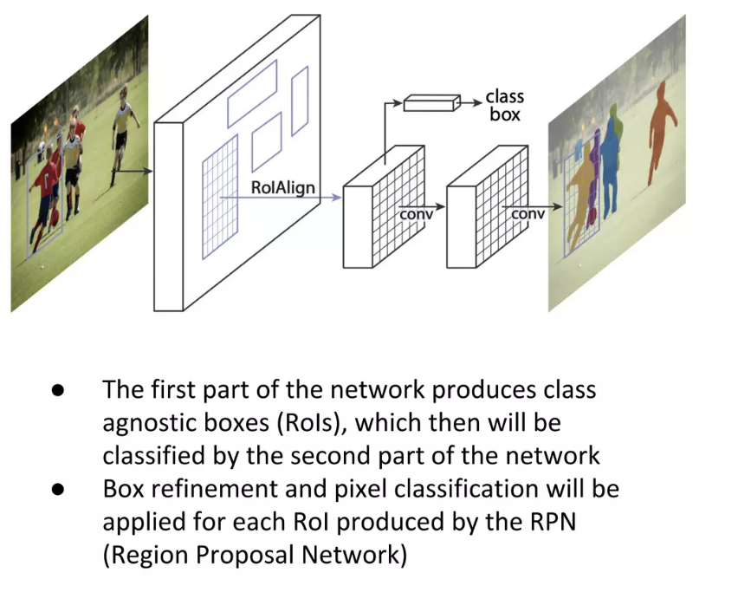
Panoptic segmentation

Slide 13
How does Panoptic Segmentation work?
The FCN(Fully Convolutional Network) is responsible for capturing patterns from the uncountable objects—stuff – and it yields semantic segmentations. The FCN uses skip connections that enable it to reconstruct accurate segmentation boundaries.
The Mask R-CNN is responsible for capturing patterns of the objects that are countable—things—and it yields instance segmentations. It consists of two stages:
Region Proposal Network (RPN): It is a process, where the network yields regions of interest (ROI).
Faster R-CNN: It leverages ROI to perform image classification and create bounding boxes.
The output of both models is then combined to get a more general output.
Notes:
Also, skip connections enable the model to make local predictions that accurately define the global or the overall structure of the object.

Slide 14
Is there any dataset for this task?

Slide 15
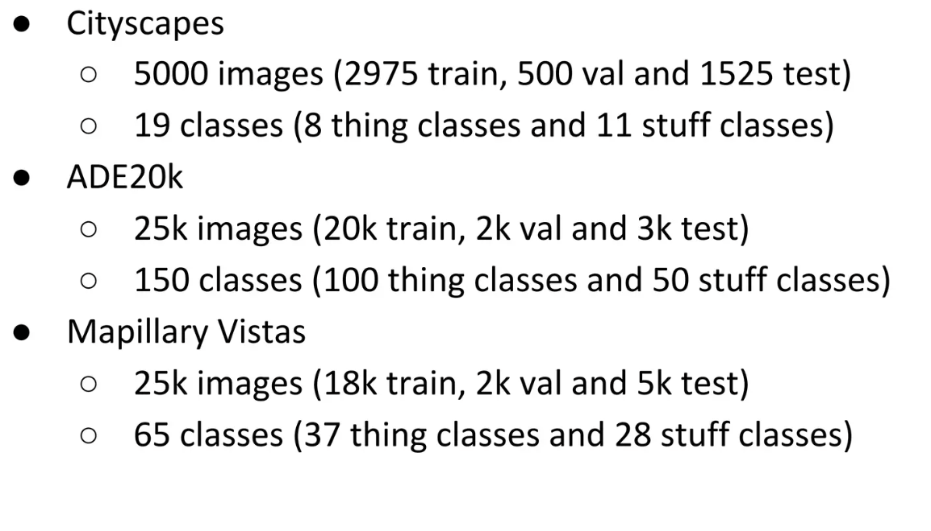

Slide 16
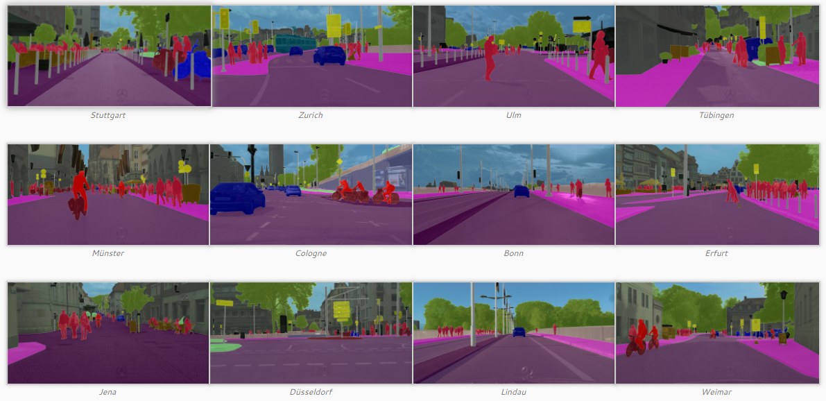
Cityscapes Dataset
The Cityscapes Dataset focuses on semantic understanding of urban street scenes.

Slide 17
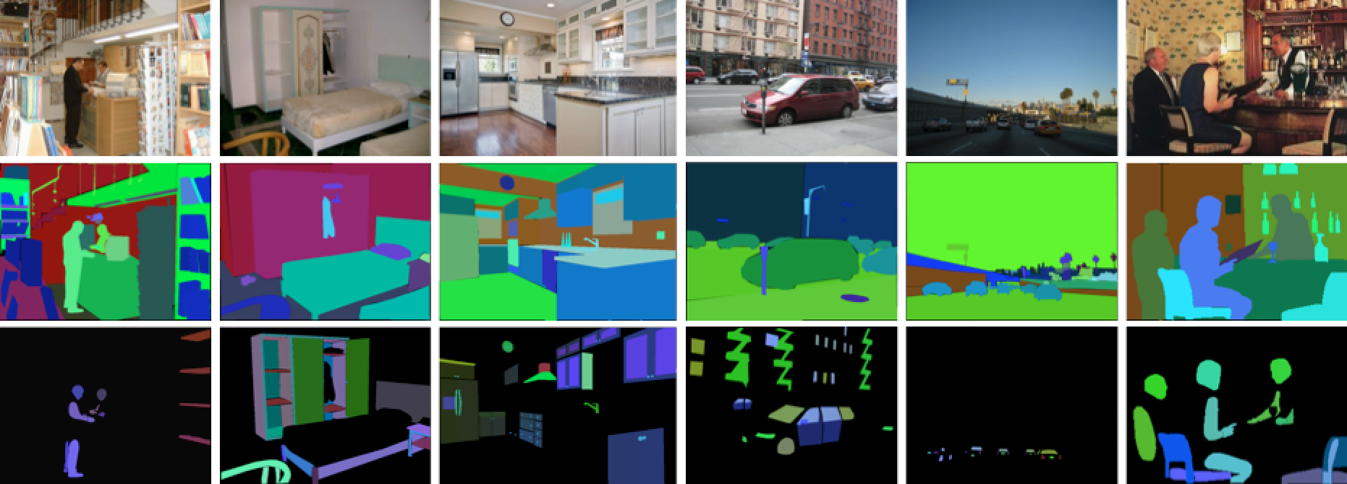
ADE20k
The annotated images cover the scene categories from the SUN and Places database. Here there are some examples showing the images, object segmentations, and parts segmentations:

Slide 18
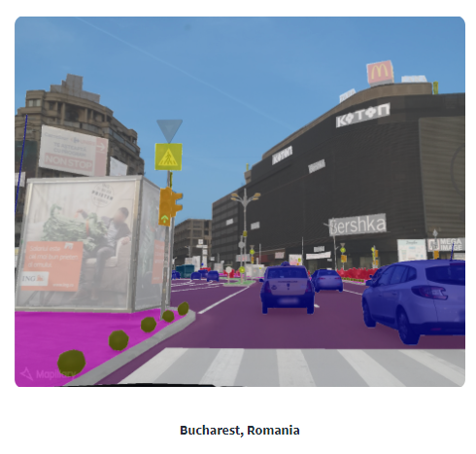
Mapilary vistas
It is an instance/semantic/panoptic segmentation dataset, which is represented as traffic-related
dataset with a large-scale collection of segmented images.It mainly focuses on street scenes

Slide 19
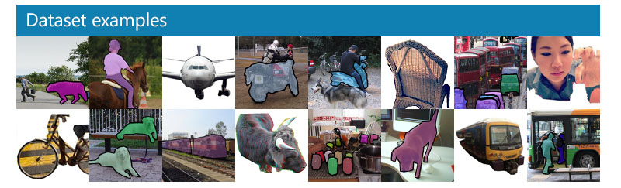
COCO Dataset
COCO(Common Objects in Context) is a large-scale object detection, segmentation, and captioning dataset. COCO has several features:Object segmentation,Recognition in context, Superpixel stuff segmentation

Slide 20
Methods Used

Slide 21
Segmentation process
Kirillov et al.
Axial DeepLab

Slide 22
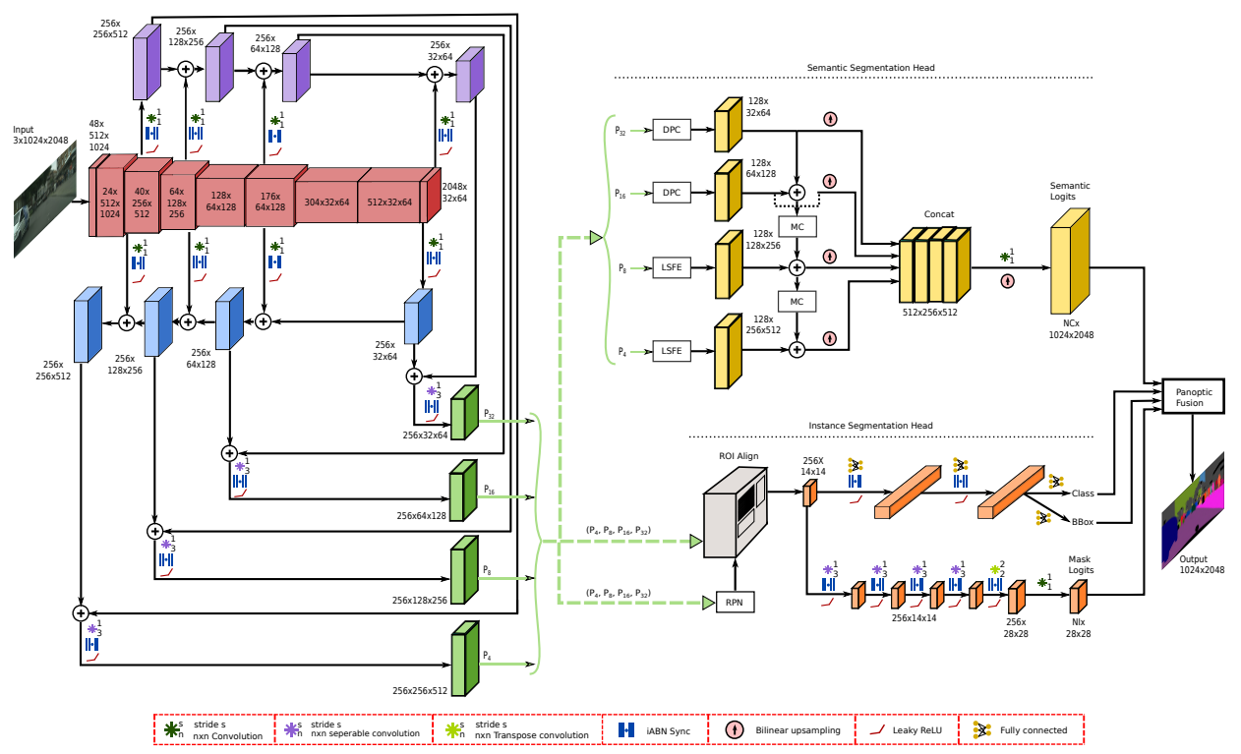
Kirillov

Slide 23
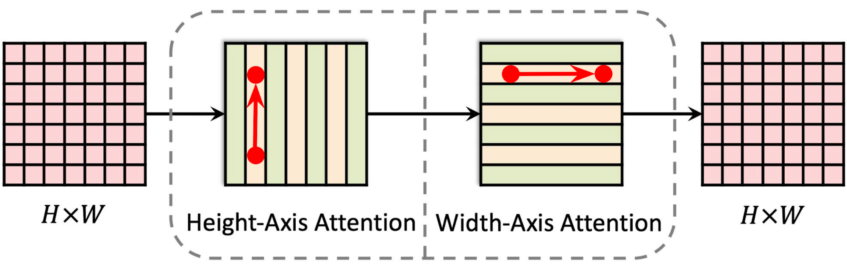
Axial DeepLab

Slide 24
Feature extraction methods used
Dinat- l
Swin

Slide 25
Dinat-l
DINAT can be used to extract features from an image by computing its DINAT coefficients.
These coefficients provide a compact representation of the image in terms of a small number of features.
The DINAT coefficients capture the underlying spatial frequency information in the image and can be used to distinguish different regions or objects in the image.

Slide 26
Swin
SWIN Transformer can be used in a self-supervised manner to pretrain a feature extractor for segmentation tasks.
This involves training the model on a large dataset using pretext tasks, such as predicting the relative positions of image patches or predicting the rotation angle of an image.
Once the model has learned useful features from the pretext tasks, it can be fine-tuned on a smaller annotated dataset for segmentation tasks.

Slide 27
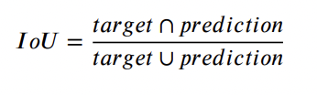
Evaluation Metrics
1.Intersection-over-union (IoU)
It is essentially a method to quantify the percent overlap between the target mask and prediction output.
This metric is closely related to the Dice coefficient, often used as a loss function during training.
It also refers to the Jaccard index.
The IoU metric measures the number of pixels common between the target and prediction masks divided by the total number of pixels present across both masks.

Slide 28
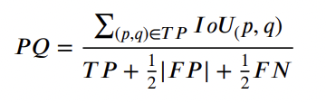
2.Panoptic quality (PQ):
It measures the quality in terms of the predicted panoptic segmentation compared to the ground truth involving segment matching and PQ computation from the matches
Three sets - true positive (TP), false positive (FP), and false-negative (FN) - and IoU between the ground truth and the prediction are required to calculate PQ.

Slide 29
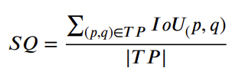
3. Segmentation Quality
The Segmentation Quality (SQ) measures the quality of the segmentation output in terms of the IoU between the predicted segmentation and the ground truth segmentation. The formula for SQ is:
Notes:
The Segmentation Quality (SQ) measures the quality of the segmentation output in terms of the IoU between the predicted segmentation and the ground truth segmentation. The formula for SQ is:
SQ = (TP)/(TP + FP + FN)
where TP refers to the true positive pixels (i.e., the pixels that are correctly classified as belonging to the foreground), FP refers to the false positive pixels (i.e., the pixels that are wrongly classified as belonging to the foreground), and FN refers to the false negative pixels (i.e., the pixels that are wrongly classified as belonging to the background

Slide 30
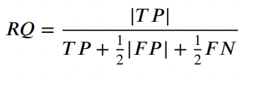
4. Recognition Quality
The Recognition Quality (RQ) measures the quality of the object recognition output in terms of the average precision (AP) of the predicted object detections. The formula for RQ is:
Notes:
The Recognition Quality (RQ) measures the quality of the object recognition output in terms of the average precision (AP) of the predicted object detections. The formula for RQ is:
RQ = AP
where AP is the average precision score, which is a measure of how well the algorithm detects and localizes objects in the image.
In summary, PQ evaluates the quality of panoptic segmentation output by measuring the quality of the segmentation and recognition components. It is a useful metric for comparing the performance of different panoptic segmentation algorithms on a common dataset.

Slide 31
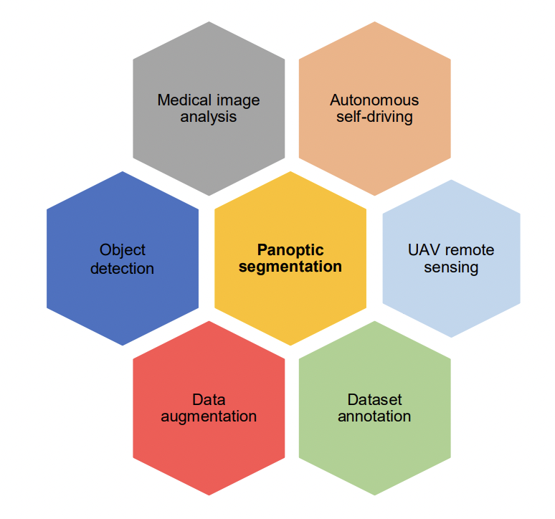
Applications

Slide 32
References
---. “The Complete Guide to Panoptic Segmentation [+V7 Tutorial].” V7, 3 Feb. 2023, www.v7labs.com/blog/panoptic-segmentation-guide.
Research Paper: A. Kirillov, K. He, R. Girshick, C. Rother and P. Dollár, "Panoptic Segmentation," 2019 IEEE/CVF Conference on Computer Vision and Pattern Recognition (CVPR), Long Beach, CA, USA, 2019, pp. 9396-9405, doi: 10.1109/CVPR.2019.00963.

Slide 33
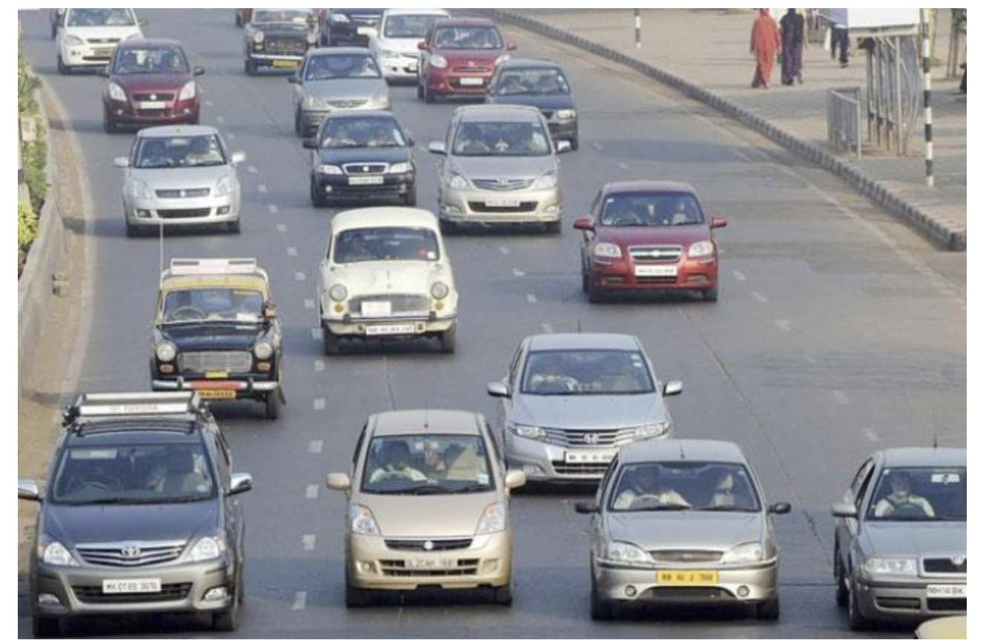
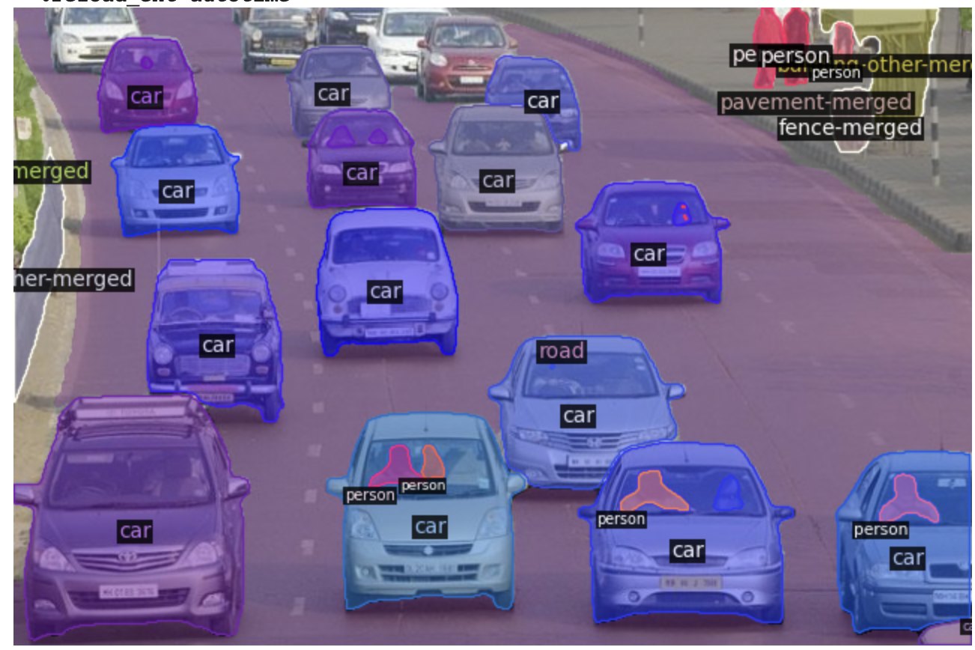
Output from the package for Indian road landscape

Slide 34

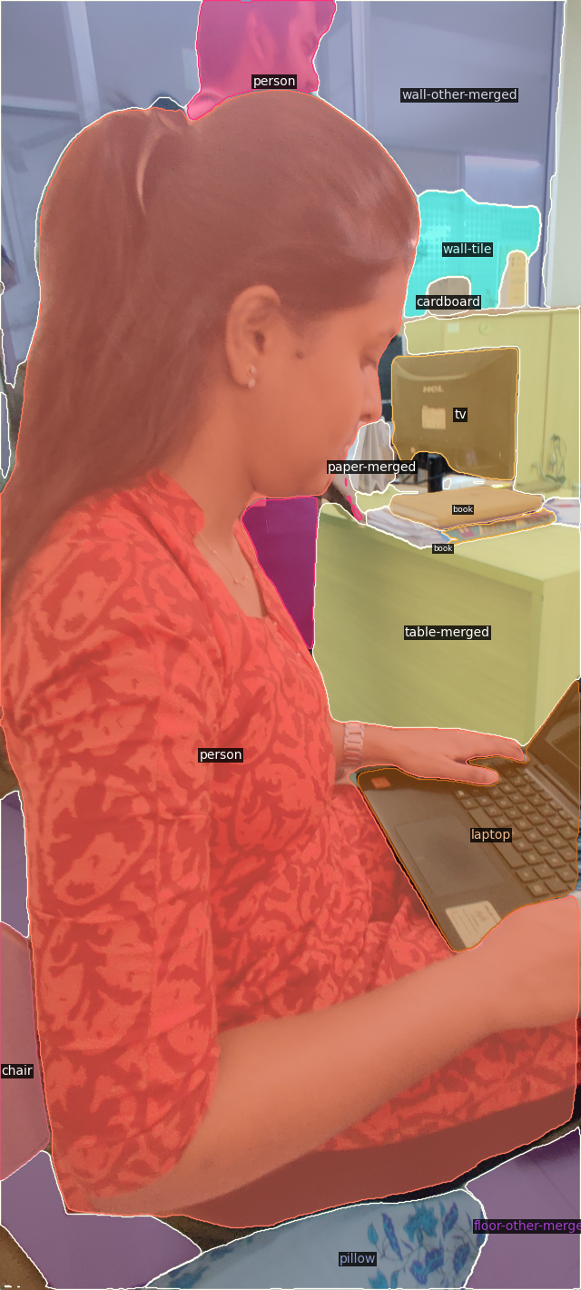
Real life output
Used the panopticon segmentation model to get output for a real life image tested during project presentation.

Slide 35
Thank you

